Slide 1


Small Business Administration Loan Data
Final Report
Sam Loyd
November 2020

Slide 2

SBA Loan Data
Acquired from Kaggle
Educational data sets
Competitions
Gathered by the Small Business Administration
Provided by American Statistical Association
Collected from 1969 to 2014
27 attributes
Key attributes
Loan repayment
Number of jobs created

Slide 3

Data Summary
Burrower
Geographic information
Bank
Geographic information
Industry Coding
Approval Date
Fiscal Year
Loan Term
In months
Number of Employees
Loan Amount
New or Existing Business
Number of Jobs Retained
Franchise Code
Revolving Line of Credit
Low Documentation Program
Urban or Rural
Disbursement Information
Loan Status
Repayment
Jobs Created

Slide 4


Why this matters
Background
Project Goals
SBA Loans are backed by the US Government
Up to 85 percent of defaults covered through tax-payer supported funding
Loan repayment is a primary concern
Limit liability
Job creation
Could maximize a return on investment
Analyze the data
Predictive models that address loan repayment and job creation
Evaluate the potential of models
Maximize model efficiency
Place effective models into production

Slide 5
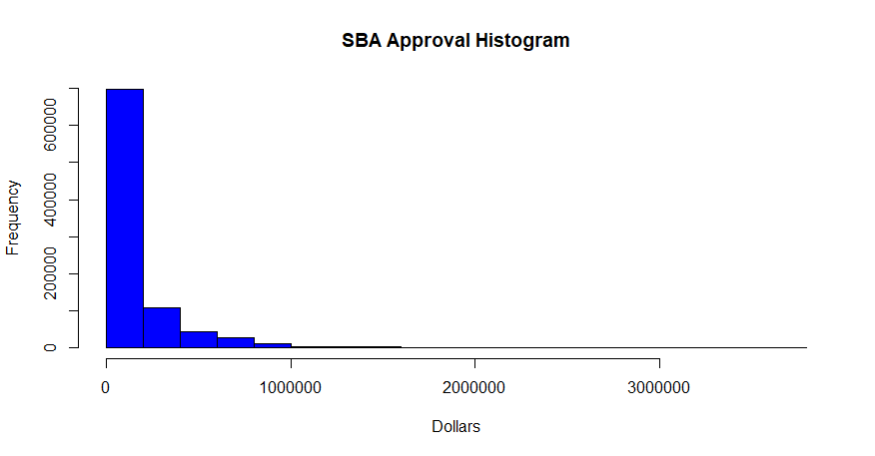

Data Understanding – Distribution
Shape
Pattern emerged
Affected by skew
Positive (right)
Non-normal distribution
Correlation methods
Spearman’s
Limited model options
Transformations (log-10)

Slide 6
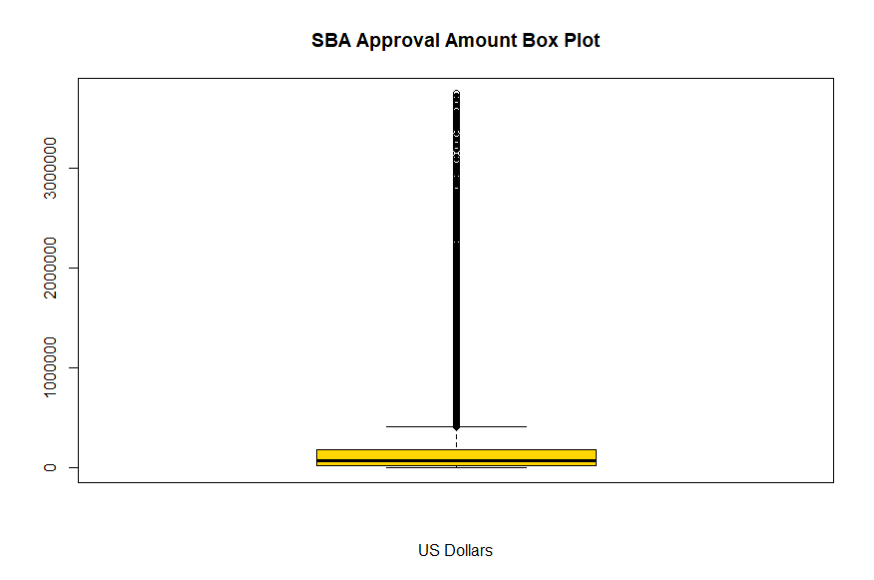

Data Understanding – Outlier Detection
Outliers
Highly affected
Valid values were retained

Slide 7
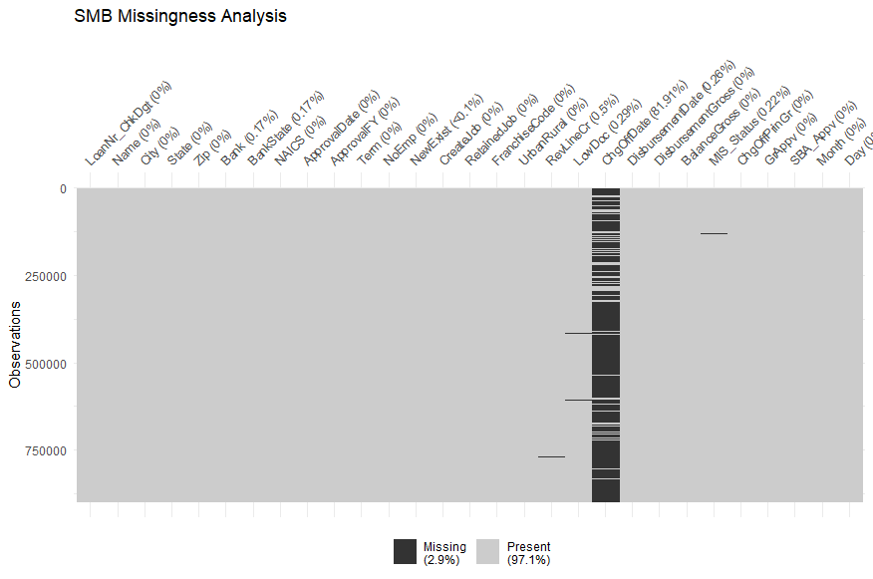

Data Understanding – Missingness
Missing Data
Charge Off Date
Removed
Retained the few remaining

Slide 8

Data Preparation
Cleansing
Time consuming
Converting data types
Loan removal
SBA loan amount was over 3,750,000
Feature creation
Loan repayment
Binary
Month of loan was used
Seasonal or Cyclical

Slide 9

Data Preparation
Encoding
Why?
Models use numbers
One-hot example: color field with red, green & blue
Encoding used
One-hot encoding for month and business setting
Categorical
Binary Encoding for individual bank and franchise
High Cardinality
More Complex
Color_Red | Color_Green | Color_Blue
1 | 0 | 0
0 | 1 | 0
0 | 0 | 1

Slide 10

Model Creation - A Decision Point
Categorical Target Variable
Loan Repayment
Classification model
Binary
Early promising results
Over 90% accuracy
Continuous Target Variable
Job Creation
Regression model
Data shape concerns
Log Transformations
Non-parametric
Problems
Abysmal results
R-squared 1-3%

Slide 11

Model Preparation
Splitting Up the Data
899,164 total loans
Training Data 60%
Testing Data 20%
Validation Data 20%

Slide 12
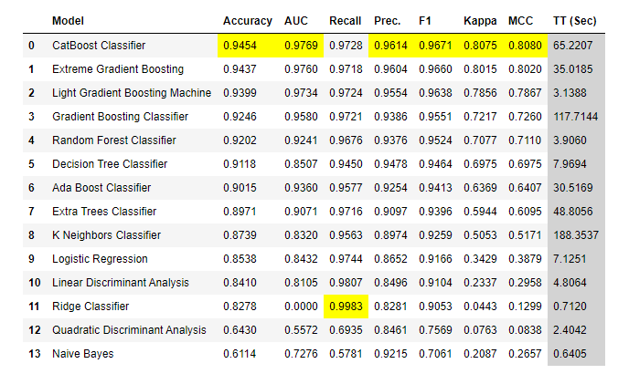

Model Creation – Classification Model
Loan Repayment Classification
Tried many classification models
Pycaret Library
Ensemble models performed best
CatBoost selected

Slide 13
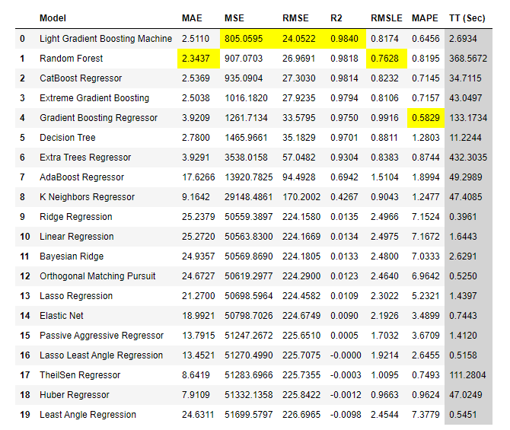

Model Creation – Regression Model
Job Creation Regression
Original scores were abysmal
Approval fiscal year and loan month
Time series or seasonality
LGBM selected

Slide 14
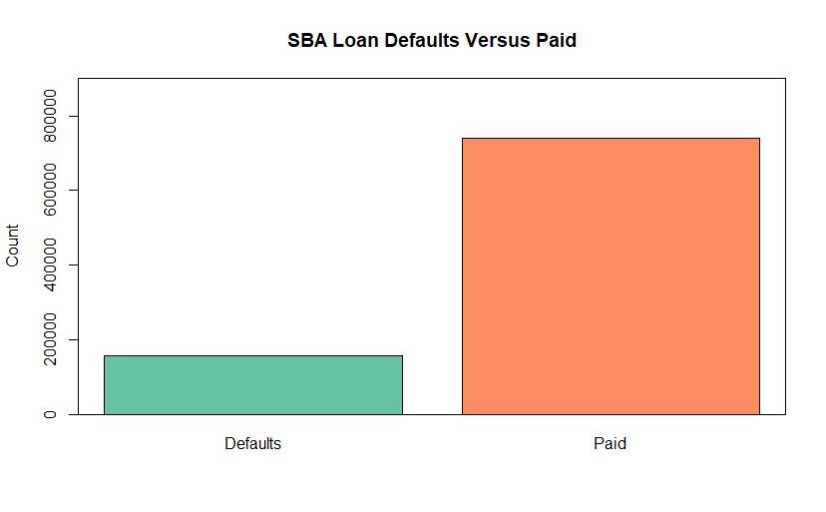
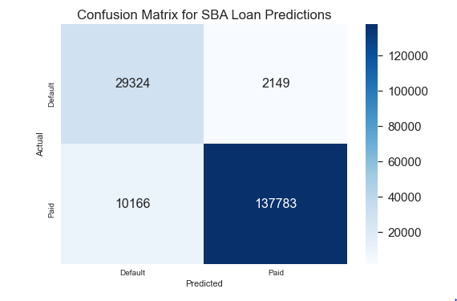
Model Evaluation - Classification
Loan Repayment – Catboost
Feature Selection - 41
Parameter Tuning
Imbalance
Testing
95% Accuracy / AUC 93%
Validation
93% Accuracy / AUC 93%

Slide 15
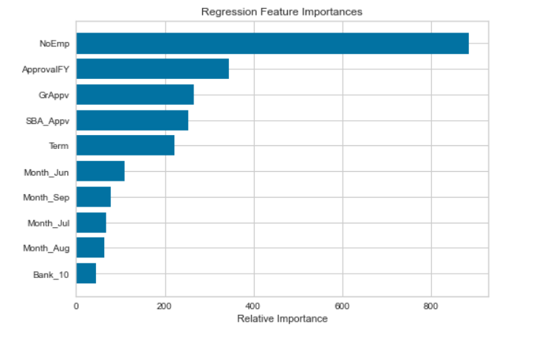
Model Evaluation - Regression
Job Creation - LGBM
Light Gradient Boost Machine
Feature Selection – over 50
Parameter Tuning
Number of estimators
Number of leaves
R-squared 99%
Test / validation
Seasonality Concerns
Probable drift
Constant retraining
Two-year delay
Ongoing maintenance

Slide 16


Deployment & Conclusions
Deployment
Team Recommendations
Both models returned good scores
Further evaluation of the regression model
Schedule jobs to monitor drift
Ongoing validation
Both models pickled for portability
Clear understanding of model goals
Understand the issues
Repeatable processes
Modular format
Test / Production
Domain Expert

Slide 17
Thank You!

